Slide 1
Superheroes or casualties? Librarians and the war on truth
Simon Bains
University Librarian
University of Aberdeen
Notes:
I’ll explain why I’m here in a moment, but I hope that I will do today what Inger expected of me after meeting me last year.
In general terms, what I will be talking about is inclusion, and the tension between the concept of libraries being neutral and the ways in which how we manage information can be seen to be fundamentally unfair and unrepresentative. I will look in particular at the issue of knowledge shaped by a colonial past, and moves to address this through decolonisation. I will also look at pressures around censorship, which also centre on the issue of inclusivity.
I will use the concept of critical librarianship as a way to think about this and stress the importance of reflecting on what our professional position should be on some very difficult issues.
I was told I didn’t need to address AI, your conference theme, as others will be doing that throughout the day, but I will touch upon it a few times.
I’m sorry for having no Norwegian at all and will be speaking to you in English. I suspect you all speak and understand it very well, but if I talk too fast, or use a word you don’t recognise, please let me know!

Slide 2
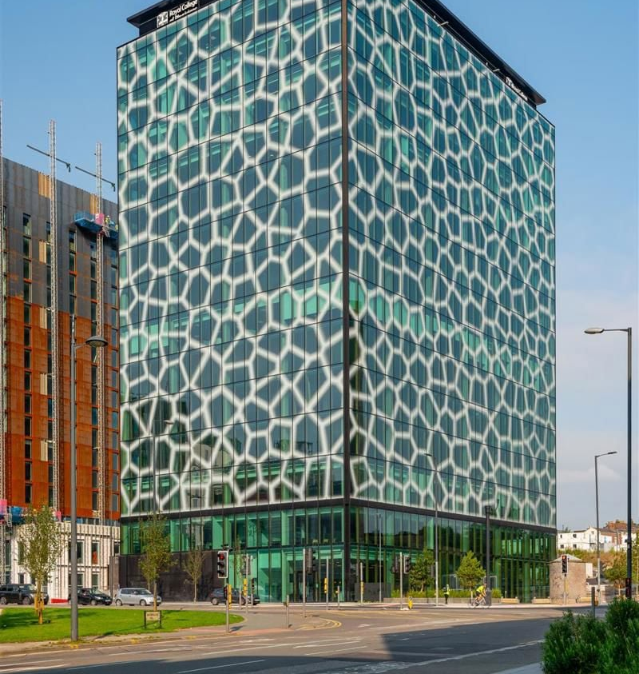

It all started here…
Notes:
The reason I’m standing here today started in Liverpool, in England, about a year ago.
A keynote speaker gave a talk, I asked a question, and at the end, the lady next to me said ‘that was very interesting, would you like to come and give a talk in Oslo?’ That lady was Inger Stenerson, and here I am, so thank you Inger for giving me this fantastic opportunity.
I’ll return to this in a moment, and explain what happened, but I’ll start with a few words about me, and where I’m from.

Slide 3
Who am I?
Simon Bains is a prominent figure in the UK academic library sector, currently serving as the University Librarian and Head of Library Services at the University of Aberdeen, a role he has held since 2019.
He is widely recognised for his expertise in Open Research, digital transformation, and scholarly publishing.
He is considered important in the library world because he is a leading "change agent" for how universities share knowledge in the digital age. He doesn't just manage books; he actively reshapes the policies that govern how global research is accessed.
He is not only as an administrator but a public intellectual voice in the open access movement.
According to Google Gemini and Microsoft CoPilot!
Notes:
The theme of your event today is AI, so I thought it appropriate to ask two AI tools who they thought I was.
They gave me a very positive response, so I’m happy to share this. I particularly like that I am a public intellectual voice in the open access movement. I couldn’t have put it better myself.
But as it notes here, I’m the University Librarian at Aberdeen. I have worked in libraries for nearly 33 years now. I’ve worked in six university libraries (four in England, two in Scotland) and one national library: the national library of Scotland.
My career has more or less progressed alongside the rise of the WWW and the advent of the digital library, and it’s been a fascinating journey.

Slide 4
The University of Aberdeen
Since 1495, the University of Aberdeen has been open to all and dedicated to the pursuit of truth in the service of others.
We achieve our purpose through excellence in our core activities of education and research which transforms the world around us.
Notes:
The University of Aberdeen has been around even longer than I have.
It came into existence in 1495, by virtue of a decree from Pope Alexander VI to support our founder Bishop Elphinstone's vision for Aberdeen to have a University that was "open to all and dedicated to the pursuit of truth in the service of others“. King's College as it was then, became the UK's fifth university, welcoming its first students in 1505.
So I can say I work at one of the oldest universities in the United Kingdom, with only four older than mine. But one of those is St Andrews, where my colleague Katie works, which I think is 82 years older…!
I like to say that I work at a university that has the world’s oldest open research mission statement. As a librarian who has been dedicated for over 20 years to making university research open to everyone, it delights me to work at a university that set out to be open to all over 500 years ago.

Slide 5

Notes:
The University of Aberdeen as it is now came into being when two colleges merged. Marischal College, founded in 1593, merged with King’s College in 1860.
Marischal College’s original medieval buildings were replaced in the 1830s, and in 1906 new construction made it the second-largest granite building in the world.
The largest is a royal complex near Madrid. The Royal Site of San Lorenzo de El Escorial, located 45km northwest of Madrid, Spain, is a massive 16th-century complex serving as a monastery, royal palace, library, and pantheon.
Today, the University has about 3,000 staff and about 14,000 students. Relatively small, which makes for a strong sense of community.

Slide 6
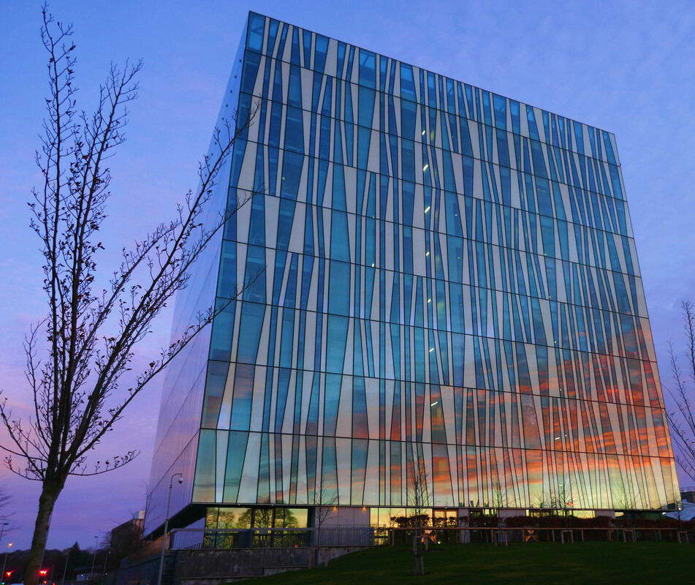

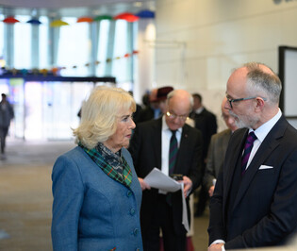
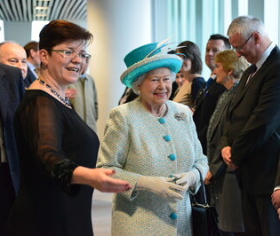
The Sir Duncan Rice Library
Notes:
And this is where I work. Very much not over 500 years old. The main library building was designed by Danish architects Schmidt Hammer Lassen and completed in 2011. It is named after Sir Duncan Rice, a previous Principal of the university. The cube-shaped building can be seen prominently from the entire campus and much of the city. It is a nine storey tower, clad in jagged stripes of white and clear glass. The building has a floorspace of 15,500 square metres. It houses several of the University's historic collections, including more than a quarter of a million rare books and manuscripts.
Contrasting with the geometric exterior, the central atrium has an organic form, shifting in location across the levels.
Across the levels above the ground there are 1,200 reading spaces. Above ground there are 13 km of shelving to hold 400,000 books.
Here you see on the right., HM QE11 with the Librarian at the time at the official opening of the Library in 2012.
On the left, 13 years later, you see me meeting Queen Camilla who visited in early 2025, and is Chancellor of the University of Aberdeen.

Slide 7
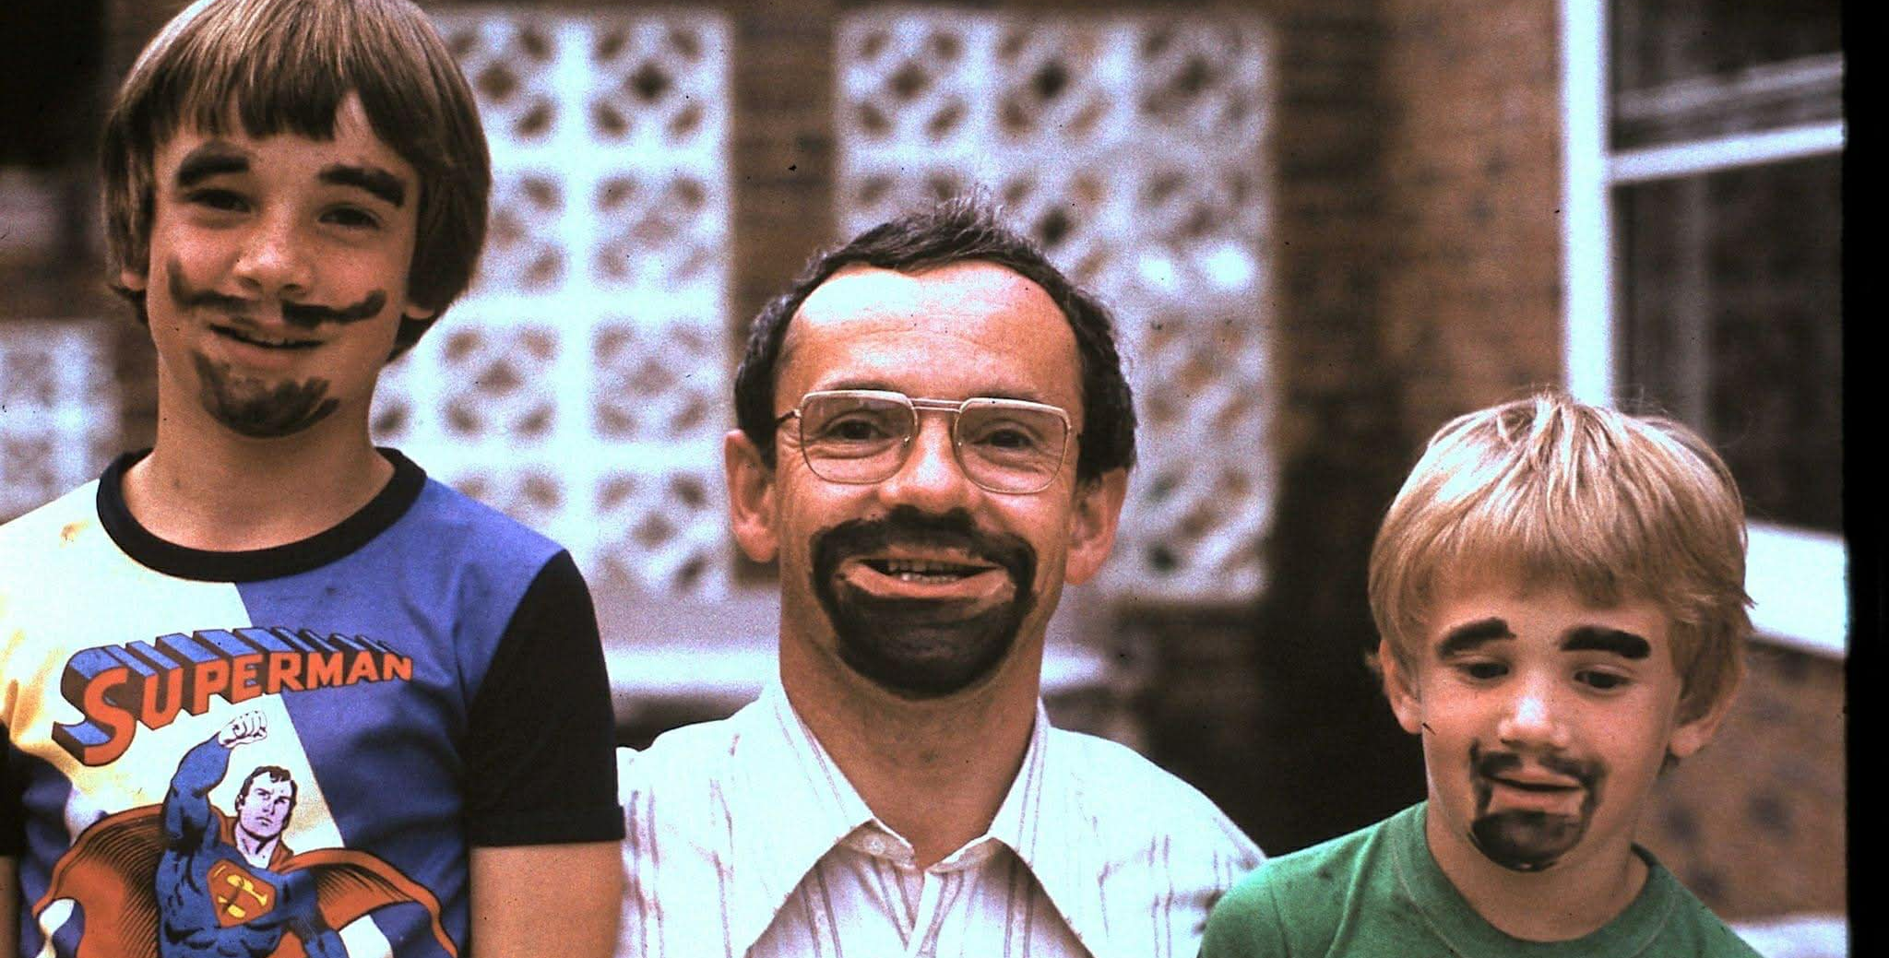
Are librarians superheroes?
Notes:
Are librarians superheroes?
This librarian certainly wanted to be a superhero. I had a vague memory of a photograph of me wearing an appropriate clothing, and I found it! This is me, on the left, wearing a superman t shirt! You can see that I had a beard, even at the age of 10, in 1979! This is my father, and my younger brother. You can’t tell, but he has a Star Wars t shirt on.
There is a story behind the reason we all have beards but come and ask me in the break…

Slide 8
It all started here…
Notes:
So you remember what I said earlier – it all started in Liverpool last year.
A keynote speaker, not a librarian, but clearly very conscious he was talking to an audience of librarians, told us we were superheroes, defending truth and accuracy. Which is nice, right? I think we all like to hear that we’re doing good and important work.
But I always like to be disagreeable, so I put my hand up at the end, and said ‘but is that really true?’ And in a moment I’ll explain what was on my mind when I asked that question.
I think we have what I’ll describe as the librarian superhero trope. It’s a figure of speech, but it’s often used by those that want to praise us for what we do.
What does it actually mean? Are we superheroes?
Or is it possible might we be part of the problem?
And if we are superheroes, is that a good thing?
And if I try to somewhat clumsily connect this to the theme of your conference, might AI be our kryptonite, capable of destroying our superpowers?

Slide 9
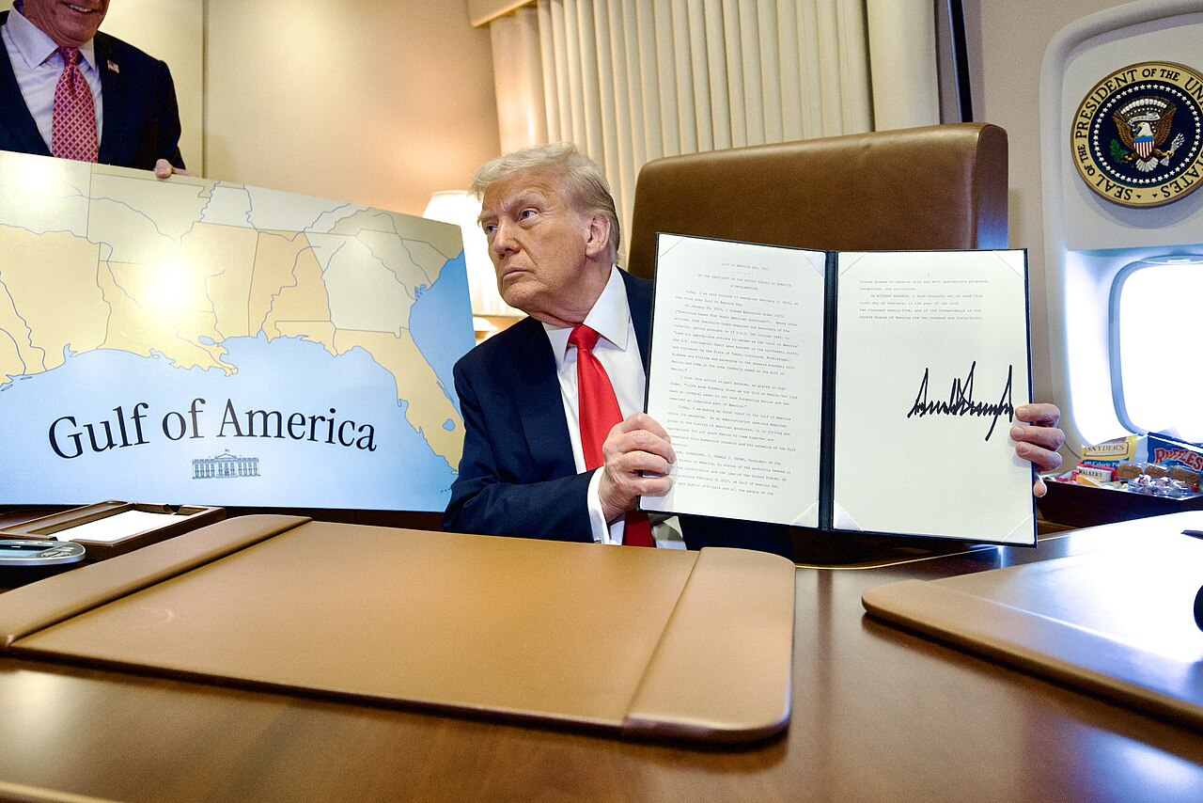
“neutrality in classification simply doesn’t exist”*
151 Mexico, Gulf of CHANGE HEADING
151 America, Gulf of [sp 85084621 ]
151 Denali, Mount (Alaska) CHANGE HEADING
151McKinley, Mount (Alaska) [sp 85082617 ]
Extract from Library of Congress Subject Headings Tentative Monthly List 13 February 2025
*Mike Olson, University of Wisconsin, writing in The Scholarly Kitchen
https://scholarlykitchen.sspnet.org/2025/03/25/guest-post-classification-as-colonization-the-hidden-politics-of-library-catalogs/
Notes:
So this is what was on my mind when I asked my question in Liverpool.
The conference took place very soon after President Trump decided that the Gulf of Mexico was actually the Gulf of America, and that Mount Denali in Alaska, should revert to Mount McKinley.
This is by no means the most destructive decision made by the 47th President of the US, of course, and I despair of his impact on the world at the moment.
But, nevertheless, the consequences of this decision concern me from a professional point of view.
Trump’s Executive Order of January 2025 was a very politically-motivated decision. “Mount McKinley” and “Gulf of America” represent a Trump and Republican world view. America is dominant, and other nations, and ethnic communities should be subservient. Mexico does not deserve to have its name attached to the surrounding sea. So what that Denali was the name used for centuries by the indigenous (original inhabitants of a region) Alaskan population?
Mount McKinley was a politically motivated name when it was proposed in 1896 in support of the candidate who became the 25th president of the US, William McKinley. McKinley never even visited Alaska, let alone the mountain named in his honour.
The Gulf of Mexico is more complicated in that it was named that by Europeans, but the term derives from the indigenous name for the original inhabitants of Mexico, the Aztecs. The proposal to change the name was originally a joke by a comedian in 2010*. Clearly Trumps America wanted to stop Mexicans coming in, kick those that were already in back out, and refuse to have anything to do with anything that isn’t American. So why not make the whole gulf American. And like so many other things he has done that we might think preposterous, Trump went ahead and did it.
And here’s my concern – as a result the LoC changed its subject headings. And because libraries the world over use LoC subject headings, the way knowledge is described, internationally, has changed. On the whim of a single man. It’s politically motivated, and yet the LoC continues to proclaim its neutrality. As Mike Olson says in the article I’ve cited here, ‘neutrality in classification doesn’t exist’.
*In 2010, comedian Stephen Colbert joked it should be named the "Gulf of America" because "we broke it, we bought it" following the Deepwater Horizon oil spill,

Slide 10
From: Subject Analysis Committee, American Library Association
To: Policy, Training, and Cooperative Programs Division, Library of Congress
To: The Library of Congress
We are writing to express our strong opposition to the proposed name changes of Gulf of Mexico and Mount Denali on Tentative Monthly List 12 LCSH 2 (February 13, 2025), as well as the manner in which this list has been shared to the cataloguing community.
The changes are not based on literary warrant, but political concerns.
…it is extraordinary for a change to be made this quickly, with one of the citations in
the change proposal dated the day the list was circulated, and that being the only day that comments will be received on this portion of the list. This goes against the considered nature of the way changes and additions should be made in a widely shared controlled vocabulary, particularly one that is used internationally.
Notes:
What was also very concerning was the speed at which it happened. What you see here is the branch of the ALA that reviews LoC changes and provides support or objections, expressing concern about that. “it is extraordinary for a change to be made this quickly, with one of the citations in the change proposal dated the day the list was circulated, and that being the only day that comments will be received on this portion of the list”. Usually they are offered several weeks to respond with views.
So let me read what Mike Olson said in that article:
“The Library of Congress Subject Headings (LCSH) system provides a prime example of embedded politics. Despite being the most widely used classification system in the world, it continues to perpetuate marginalization through its controlled vocabulary. While claiming to be a neutral knowledge organization tool, it systematically under-represents the experiences and terminology of marginalized communities, preserves outdated and sometimes offensive language, and structures knowledge in ways that center dominant perspectives.
Olsen also references the longstanding term ‘illegal aliens’ as an authorised subject heading. Which brings me to my next slide…

Slide 11
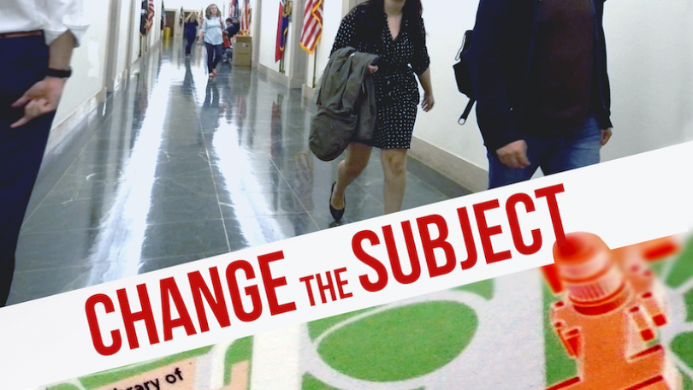
Notes:
Change the Subject (2019) is a 2019 documentary film about a group of University of Dartmouth students who challenged anti-immigrant language in the Library of Congress subject headings.
Their advocacy took them all the way from their university library in Massachusetts to the united states Congress, showing how student activism entered the national spotlight, and how a cataloguing term became a flashpoint in the immigration debate in Washington DC. In partnership with library staff at Dartmouth, these students – now alumni – produced a film to document this story. The impact of the film inspires librarians like me to examine the ways that systemic racism pervades the institution of the library, particularly in its controlled vocabularies.
I’m not going to show you the whole film but this is the trailer (the advert for the film). It’s about three minutes.
https://www.youtube.com/watch?v=Ebphd5Rg6c8
(Use settings to change subtitles to Norwegian).

Slide 12
Are we superheroes, or part of the problem?
“Librarianship has been complicit, if not responsible, for perpetuating colonial approaches to knowledge by replacing traditional knowledge with Western knowledge, especially in physical libraries established under colonial regimes, by failing to maintain the authority of the indigenous people who produced the knowledge, or by stealing or appropriating the knowledge without appropriate compensation.”
Sandy and Bossaller (2017), Providing Cognitively Just Subject Access to Indigenous Knowledge through Knowledge Organization Systems, Cataloging & Classification Quarterly, 55 (3).
Notes:
So this makes me wonder if we should be less comfortable being branded superheroes – it makes me feel part of the problem.
So much of what we might regard as facts, or neutral labels for facts, are bound up in a world in which a dominant minority imposed their will on a global but weaker majority. And what we see here is that dominance being reinforced by a single man in the Whitehouse and obeyed by one of the world’s most influential libraries.,
This is a quotation from a paper in Cataloguing and Classification Quarterly, accusing our own profession of perpetuating colonial approaches to knowledge.

Slide 13
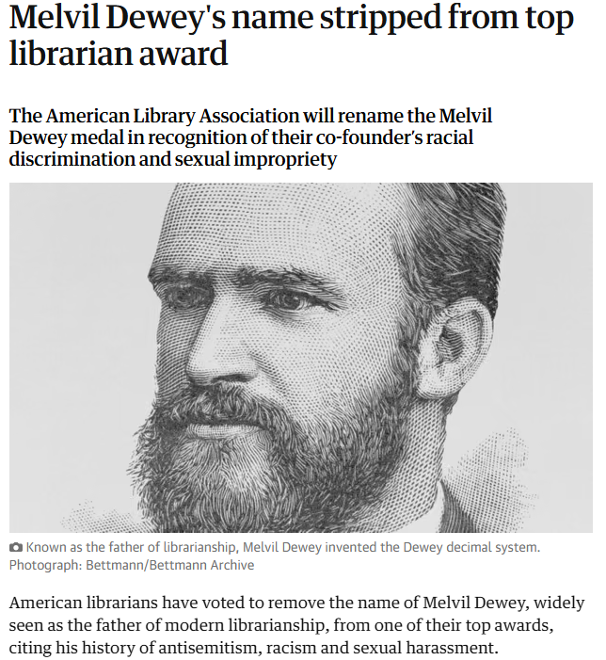
“Library classification systems are historically rooted in coloniality”
Reyes (2025) Cataloguing the Empire: classification as colonial project. Catalogue and Index 210
The Guardian newspaper, 27 June 2019
Notes:
We might say very similar things about classification.
Melvil Dewey formed his classification scheme in 1876 and it was of course hugely influential the world over, including the United Kingdom and Norway.
But the system's logic reflects the cultural and social biases of its time. For example, the 200s category is for Religions, but all numbers until the 290s are exclusively for Christianity, with other religions combined with mythology.
Dewey himself held racist, misogynist, and anti-Semitic views, which influenced the system's classification (Joseph, 2021). The paper I note here, from Catalogue and Index, Jimenez et al. (2022) note the ‘particularly unfortunate legacy’ of the most common library classification systems, including ‘antiquated, often racist, assumptions about the ordering of the world.’ These systems not only complicate navigating library resources but also cause harm. Library classification systems are historically rooted in coloniality.
(From Reyes).

Slide 14
Critical Librarianship
“considerations for the human condition and for human rights take precedence over other professional concerns”
Samek, T (2007) Librarianship and Human Rights: A Twenty-First Century Guide
“If knowledge is power, then a key part of professional ethics for info professionals should be: Who are you empowering?”
Rundle, H (2014), inthelibrarywiththeleadpipe.com
#critcat: critical cataloguing, the ethical implications of library metadata, cataloguing, and classification standards, practice, and infrastructure.
http://critlib.org/critcat/
Notes:
Awareness of these issues led to the development of the concept of critical librarianship. Its supporters argue that it is wrong to maintain that libraries should be neutral, and impossible to say that they are, given their reliance on Western and colonial ways of representing knowledge. Samek argues that we must place human rights above our other professional concerns. Rundle notes that we need to consider the famous quotation ‘knowledge is power’, an ask, for whom?
Arising from this sort of thinking, we now see a large community of ‘critical cataloguers’, and there is much to read about how metadata and associated standards shape how well we represent, or underrepresent, our communities.
At Aberdeen, we now offer a feedback form within our Primo discovery platform for our users to suggest improvements to our terminology. But we have also seen a reduction in our cataloguing staff, so while we are increasingly aware of the issues, we are less and less able to address them.

Slide 15

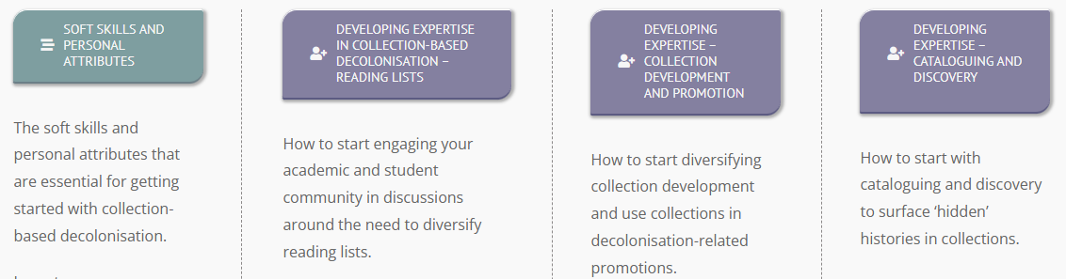
https://www.rluk.ac.uk/inclusive-collections/#dicg
Notes:
And of course, this extends not just to how we describe knowledge, but also the knowledge that we collect.
In the UK, our national network, Research Libraries UK, who held that conference in Liverpool, if you remember, have done a lot of work recently to develop a guide to address these things. It helps librarians think about how best to make their collections more diverse and more inclusive.
Let me read an extract from the introduction to this guide:
“Engaging in collection-based decolonisation can yield many benefits for libraries; however, in order to achieve real change, it can also be complex and disruptive. As a result, it can often be misunderstood both within the library community and beyond. This work is not about deleting the existing record or re-writing history but about providing context and including more diverse perspectives and differing world views in library collections. The aim is that of generating dialogue and debate that expand knowledge horizons”
Do I think this is a good thing? Absolutely. Do I think my colleagues who have done this work are the superheroes of our profession? Yes, I do. But not everyone does, and that is one of the reasons I respect them for standing up to attack, and strong disagreement.

Slide 16
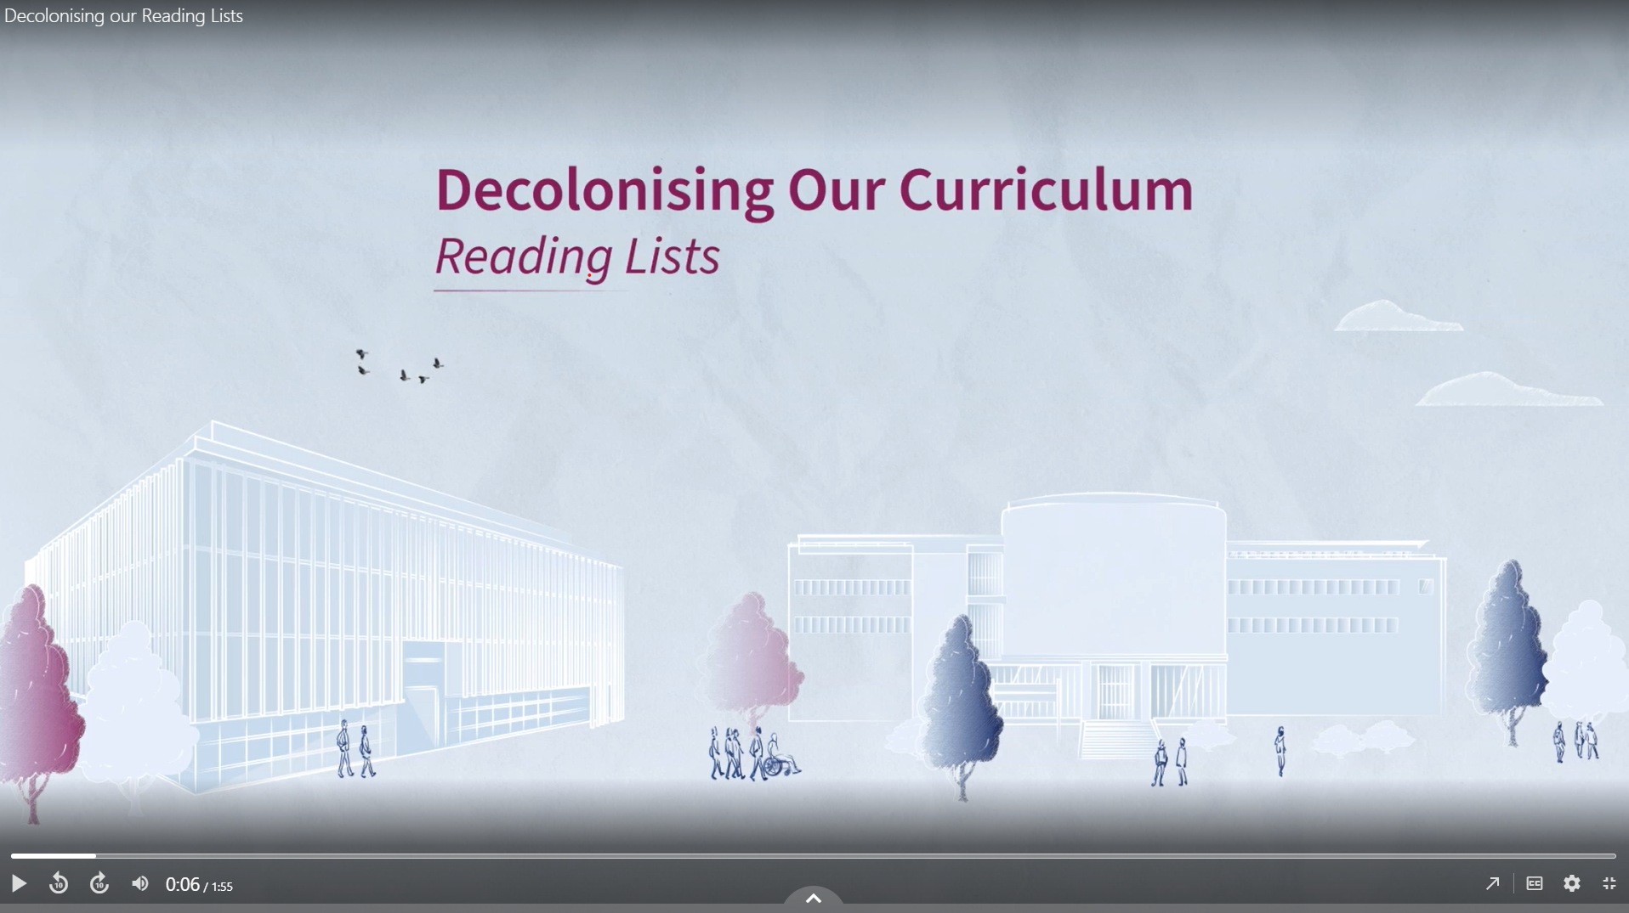
Notes:
In my view, and that of my institution, decolonisation is both vital and intellectually defensible. What can be wrong with adding to your collection to better represent a full range of thinkers and cultures. To correct the oversights of previous generations in ignoring, or being ignorant of, theories, ideas, discoveries and inventions which occurred beyond what we now term the global minority of countries who saw themselves as superior, and were able to assume imperial leadership over the nations and cultures they deemed inferior?
This is a guide which forms part of a major university project to decolonise the curriculum a few years ago.
https://abdn.cloud.panopto.eu/Panopto/Pages/Viewer.aspx?id=f69ec265-67ad-4787-aa1a-b2c100f57691&start=0
Do I think my colleagues are superheroes for doing this, in the face of criticism from those who say that this is ‘woke’ nonsense? Yes, I do.

Slide 17
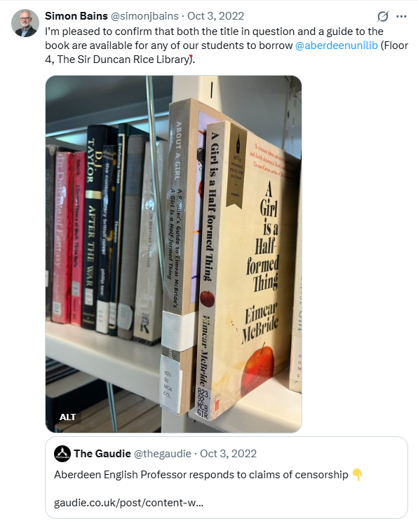
“Removing” books
“University lecturers treating young adults as though they are children, and encouraging them to think of themselves as children, seems to me to do intellectual disservice to all concerned while also displaying a depressingly unimaginative disregard for the transformative power of literature”
Eimear McBride
Notes:
Through ignorance, or perhaps deliberately, libraries and universities are attacked for trying to do what we feel is right. We wish to represent more communities. We wish to recognise that the lived experience of some of our communities makes it difficult to engage with some of the works we hold, so we make sure they have warning of this. These trigger warnings have been heavily criticised, and often misunderstood.
Here we have an example of an author’s bad tempered response on hearing (incorrectly) that their book as been removed from a reading list, and the newspaper coverage of this assumed it had also been removed from the library. Actually, neither thing was true, in this case. The students were simply offered a choice. The book wasn’t even removed from the reading list, let alone the library. I felt the need to make it clear that it was still there, so this is something I posted on what was still called Twitter at the time.
Those that shout loudest about free speech being important for a good education seem also those that are least likely to think critically about what they read, which I find amusingly ironic when I’m managing not to be furious about it.

Slide 18
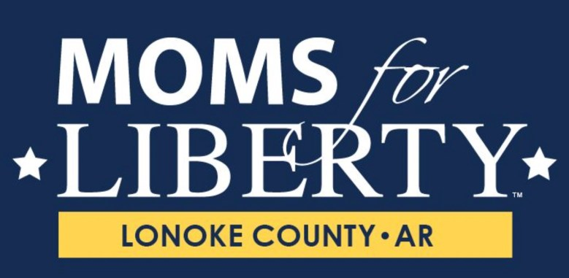
“I’m telling you, if I had any mental issues, they would all be plowed down by a freaking gun right now.”*
* https://arktimes.com/arkansas-blog/2022/06/16/secret-moms-for-liberty-audio-captures-threatening-rhetoric-targeting-a-school-librarian
Notes:
And it gets a whole lot worse.
I don’t know if you’re familiar with this group.
Moms for Liberty is an American political organization that advocates against school teaching that mentions the rights of sexual, gender and race minorities, or discrimination. They have campaigned to ban books that address gender and sexuality from school libraries. Founded in 2021, the group began by campaigning against COVID-19 responses in schools such as mask and requirements for vaccines.
This quotation is from an audio recording from a Moms for Liberty meeting in Arkansas and it was directed at school librarians. The speaker is a leading member of the group. She was subsequently banned from school grounds. She responded that was too harsh a punishment for threatening to gun down librarians.

Slide 19
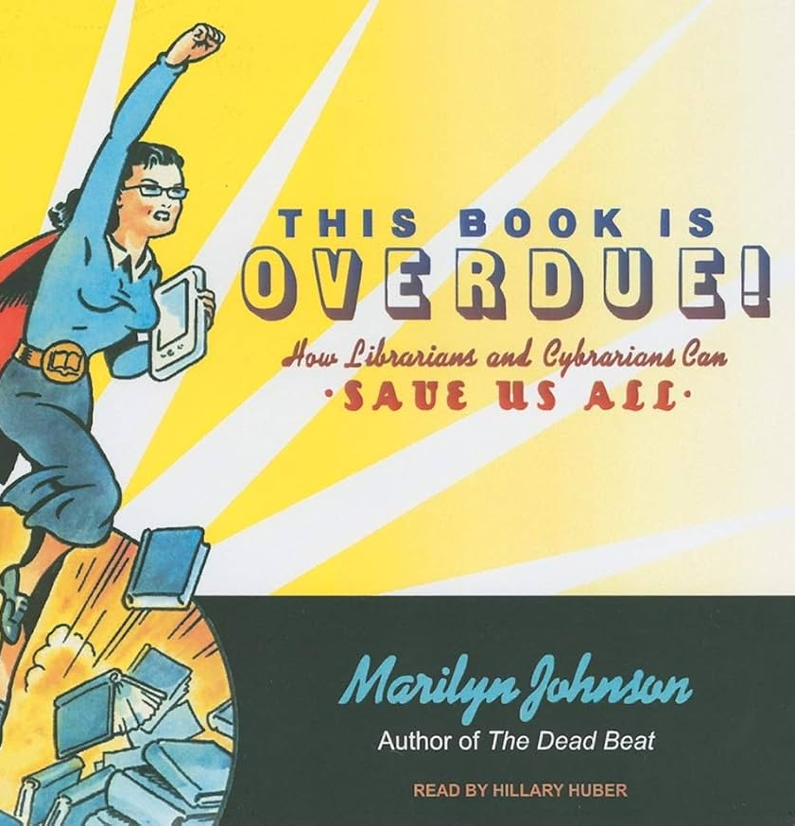
“Library staff are not superheroes. They’re not magical, or extraordinary, or phenomenal.”*
the problem with the hero narrative is that it emphasizes ‘bravery’ for those who work under hazardous conditions—rather than outrage over the continued existence of such conditions…no one should be forced to be brave
King, R (2021), I am Not a Badass: Against the Librarian-as-Superhero Stereotype, Urban Library Journal, 27(2).
* https://raforall.blogspot.com/ Library Staff Are Not Superheroes: a Guest Post by Robin Bradford
Notes:
This takes me to my next point. While I might enjoy being regarded as a superhero, some do not. Do we enter our profession to defend our collections, premises, patrons and staff from political extremists. Most of us do not. Did the librarians at the end of death threats anticipate that when they decided to become librarians?
Is it wrong to give in and remove books from shelves if you are scared of the consequences? Is it right to be expected to be a superhero when your wages are low and your Library under-resourced?

Slide 20
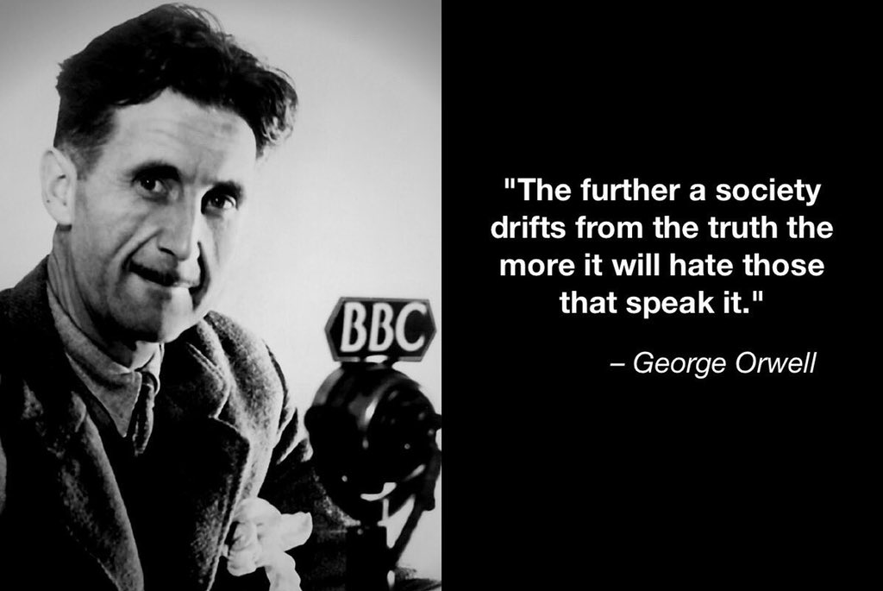
Notes:
I’m getting close to the end of my talk now. So at this point in my preparation I was looking for a good quotation to finish on. This quotation felt very appropriate. How true it feels, that this is the reason that liberal thinking librarians are hated so much by a growing right-wing faction who seek to replace facts with their own distorted version of reality.
The trouble, and irony, is, that this in itself, is not true. George Orwell never said this. Google it and you’ll find that it’s cited widely across the Internet by the many sites that collect inspirational quotations. But in 2021, the Reuters news agency, and the Orwell Society, officially debunked it. (‘debunk’ means to expose a claim as false). The person who did actually said this is Selwyn Duke, a freelance writer from New York. He describes himself as a “teller of Truth and leftists’ worst nightmare”.
Mr Duke opposes gun control, is sceptical about the theory of evolution, describes immigration as an existential threat, and dismisses climate change.
The lessons I take from this are always check your facts, don't rush to believe something because it appears to reinforce your own view. We call this an echochamber in English – where we build an environment around us where we only encounters information that reflects and reinforces their own opinions

Slide 21
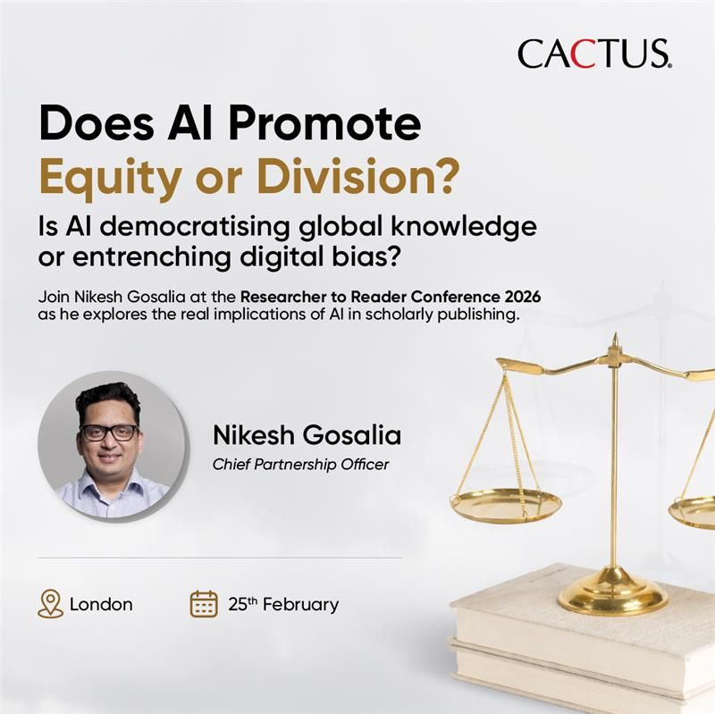
Is it about to get a whole lot worse?
https://www.youtube.com/watch?v=ZYIsSTqUiig&t=5s
(5:00” – 9:00”)
Notes:
The world now routinely uses AI LLMs to discover knowledge. Even if we don’t intend to, it’s likely that a Google search will include an AI response.
But these LLMs are trained on a biased knowledge base, as most published knowledge comes from a dominant western perspective that ignore marginalised communities. And not only that, but it creates a workflow that will make this worse and worse. I want to highlight an excellent recent talk at a conference I attended in London in February, called Researcher to Reader.
Here, Nikesh Gosalia, the president of a research publishing technology company, presents a story of how a medical researcher in Western Africa might experience an AI-driven scientific publishing world.
He explains how at every stage – literature review, peer review, publication, and post-publication indexing, generative AI reinforces a colonial skewed perspective, and he concludes that in a Gen AI world ‘Western African Research isn’t really part of global knowledge”.
As librarians in an open access world, we are now very much part of the research publishing process. We need to think about how we can help fight against the damage this could do to individual researchers and the resulting loss of valuable knowledge to the world.
(5:00-9:00 the Nigerian researcher story.)

Slide 22

What should you do about it?
Reflect: consider and challenge your own views and actions.
Challenge: what needs to change? Who has agency to change it?
Participate: get involved and learn from others
Be kind to yourself: being a superhero is not in your job description
“Nobody changes the world on their own”
https://www.youtube.com/watch?v=Vzf-z8HNHmA
Notes:
I leave you with much to think about, I hope. I don’t leave you with any easy answers. My advice is this:
In the spirit of critical librarianship, take time to critically assess your own views. Do you agree with what I’ve said? You may not, and that’s fine. But these are difficult issues, and it’s our professional responsibility in my view to think hard about them, consider our professional values and be authentic in how we position ourselves at what is a complex and challenging time for our profession.
If I’ve left you feeling strongly that change is required, what steps can you take? Who has the agency to make these changes? It may not be you, but do you feel able to influence others? Many of the good things happening in my library happened because my colleagues persuaded me that they should, not because I told them that they should.
Get involved – in the UK there are various groups discussing these issues. I don’t know how true that is here, and perhaps you can tell me. But joining these groups and getting involved is a good way to learn, and to take collective action.
And finally, enjoy feeling like a superhero and taking those compliments from those that wish to tell you that. But don’t feel you have to be. No one should be expected to be superhuman just to do their job – be kind to yourselves. In the words of Chris Hadfield, the inspirational Canadian astronaut, no one changes the world on their own. I know this is true as I watched him say it, and the YouTube link is here.
This is Chris Hadfield singing Space Oddity to the world from the International Space Station. You should all be very grateful that I’m not going to finish by singing to you.

Slide 23
What does Google Gemini think?
Hi Google Gemini, is Simon Bains, the Librarian, a superhero?
Simon Bains is not a fictional superhero with capes or powers; he is a real-life figure in the academic world.
So, while he might be a hero to students looking for research papers, his "superpowers" are strictly limited to information literacy and library management.
The "superhero" label likely stems from a specific talk he gave titled "Superheroes or casualties? Librarians and the war on truth".
Notes:
So to ask AI about me once again, I asked Gemini if I was a superhero.
Disappointingly, it’s very clear about the facts in relation to me – I’m not.
Interestingly it says that I might be mistakenly called a superhero as I once gave a talk on the subject. Well, I hadn’t then, but I have now!

Slide 24
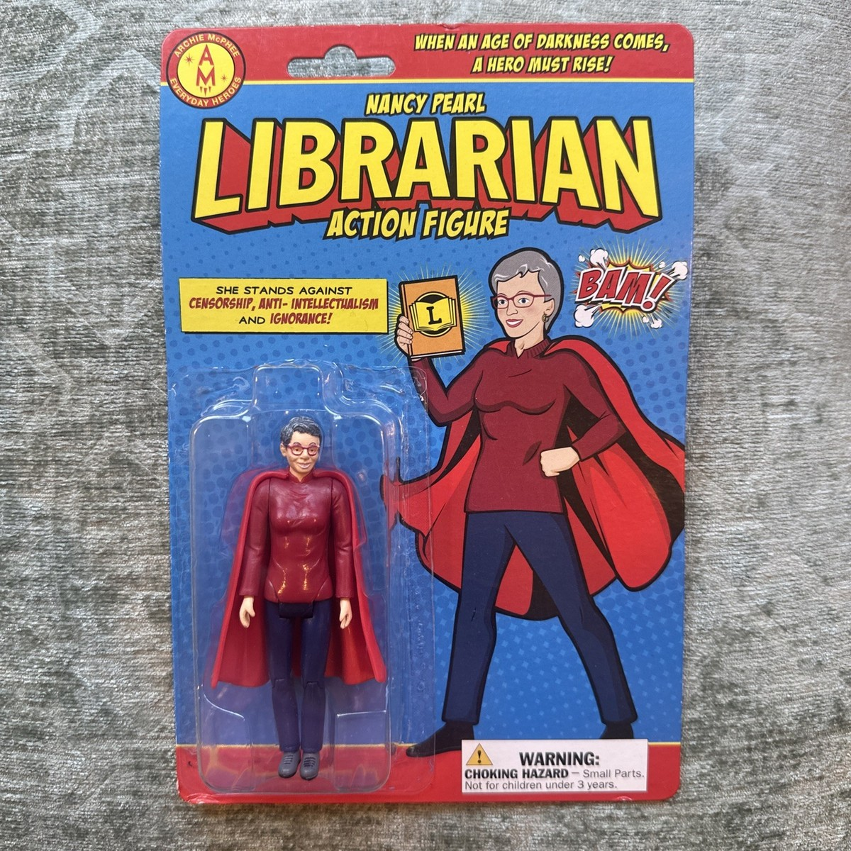
Thank you!
Notes:
And if you want your own superhero librarian, apparently you can buy one.

